Slide 1
A confectionery
- A Design Pattern Project

Slide 2
Team Members & Guidance faculty
Aniket Shrivastava 181B033
Animesh Gautam 181B034
Ashish Kumar Gupta 181B054
- Dr . Prateek Pandey
- Dr . Dinesh Kumar Verma

Slide 3
Overview
Introduction
Problem Statement
Class Diagram
Implementation
Output

Slide 4
Introduction
The project helps a confectioner generate a bill. After the customer decides upon the choice of flavors he wishes to order. The program uses the Decorator Pattern to calculate the bill. Now the confectioner realizes that the combination he served were not working out and instead changes the menu so that the customer decides to serve only a single flavored ice – cream and that too following a very rigid procedure. The design also incorporates the use of the Singleton Pattern in baking the pastry using singleton class microwave oven.

Slide 5
Problem Statement
You start your Pastry Shop that offer different types of Pastries Pineapple with chocolate, Strawberry with apple, Vanilla ‘O’ custard, Orange ‘E’ chocolate and many more No doubt about that in the future more such delicious are expected. You also need to generate a bill to the customer this way.
Pineapple = 44 Rs
Chocolate = 24 Rs
Pineapple with Chocolate with Chocolate = 44 + 24 + 24 = 92 Rs
Cost of Custard = 64 Rs
Strawberry = 34 Rs
Vanilla = 39 Rs
Write a program that can take care of present offerings and future offerings for billing. After some time, the Pastry Shop owner realised that the customer cherished single Pastry flavours more than the combination of two pastry flavours. Therefore, he came up with new menu that followed pastry rigid procedure.

Slide 6
Example: -
In order to prepare the Pineapple pastry, one needs to add 7ML of pineapple essence add corn starch min for about 10 min and the pastry is served by the waiter.
For Chocolate Pastry one needs to add 1ML of chocolate, add chocolate powder min for about 7 min and the pastry is served by the waiter.
For Strawberry one need to add 27 grams of strawberries add brown flavour min for about 6 min and then the pastry is served by the waiter.
For Apple Pastry one needs to add 13 ML of apple widen vinegar add apple minutes for about 12 minutes and then the pastry is served by the waiter.
For Vanilla Pastry one needs to add 5ML of vanilla essence add wheat flavour, minutes for about 2 minutes and the pastry served by the waiter.
For Custard Pastry one needs to add 12 grams of custard powder add corn flavour, min for about 5 minutes and then the pastry is served by the waiter.
For Orange Pastry one needs to add 17 grams of orange extracts add min for about 8 minutes and the pastry is served by the waiter.

Slide 7
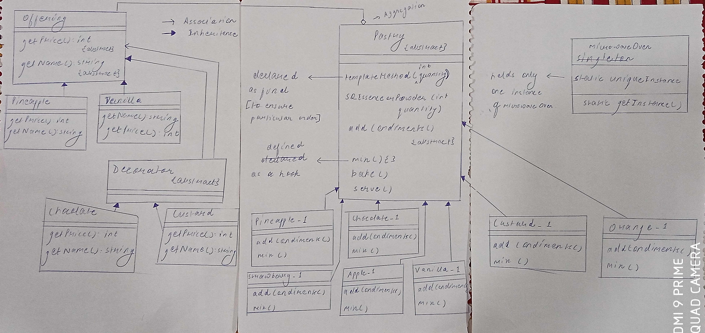
Class Diagram

Slide 8
Implementation
The four classes namely Pineapple, chocolate, vanilla and custard are shown below :

Slide 9
Pineapple.java
class Pineapple extends Offering{
String getName(){
return "Pineapple";
}
int getPrice(){
return 44;
}
}

Slide 10
Chocolate.java
class Chocolate extends Decorator {
Chocolate(Offering offering){
this.offering=offering;
}
String getName(){
return offering.getName()+" with Chocolate";
}
int getPrice(){
return offering.getPrice()+24;
}
}

Slide 11
Vanilla.java
class Vanilla extends Offering{
String getName(){
return "Vanilla";
}
int getPrice(){
return 39;
}
}

Slide 12
Custard.java
class Custard extends Decorator {
Custard (Offering offering) {
this.offering=offering;
}
String getName(){
return offering.getName()+" with Custard";
}
int getPrice(){
return offering.getPrice()+64;
}
}

Slide 13
The abstract class offering is also shown below :

Slide 14
Offering.java
abstract class Offering{
abstract int getPrice();
abstract String getName();
}

Slide 15
Now the decorator class is the main game changer as it enable one to add new classes in the future without affecting the behaviour of the previously created classes.

Slide 16
Decorator.java
abstract class Decorator extends Offering{
Offering offering;
}

Slide 17
Now for the second part the classes Pineapple_1,Chocolate_1,Strawberry_1, Apple_1,Vanilla_1,Custard_1,Orange_1 are shown below :

Slide 18
Pineapple_1.java
public class Pineapple_1 extends Pastry{
public void addCondiments(){
System.out.println("Add Corn Starch Please");
}
public void mix(){
System.out.println("Mix for about 10 minutes");
}
}

Slide 19
Chocolate_1.java
public class Chocolate_1 extends Pastry{
public void addCondiments(){
System.out.println("Add Chocolate Powder Please");
}
public void mix(){
System.out.println("Mix for about 7 minutes");
}
}

Slide 20
Strawbarry_1.java
public class Strawberry_1 extends Pastry{
public void addCondiments(){
System.out.println("Add Brown Flour Please");
}
public void mix(){
System.out.println("Mix for about 6 minutes");
}
}

Slide 21
Apple_1.java
public class Apple_1 extends Pastry{
public void addCondiments(){
System.out.println("Add Apple Pie Please");
}
public void mix(){
System.out.println("Mix for about 11 minutes");
}
}

Slide 22
Custard_1.java
public class Custard_1 extends Pastry {
public void addCondiments(){
System.out.println("Add Corn Flour Please");
}
public void mix(){
System.out.println("Mix for about 5 minutes");
}
}

Slide 23
Orange_1.java
public class Orange_1 extends Pastry{
public void addCondiments(){
System.out.println("Add Orange Extracts Please");
}
public void mix(){
System.out.println("Mix for about 8 minutes");
}
}

Slide 24
Now the Commonality between the above classes is abstracted in the class Pastry which therefore act as a template for addition of new classes :

Slide 25
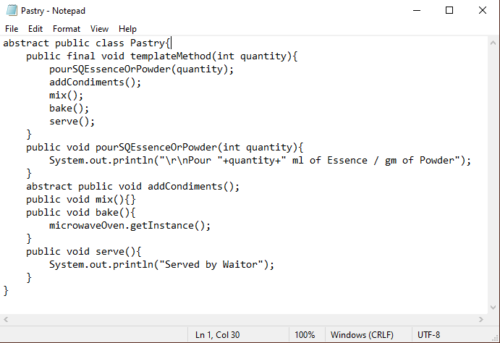
Pastry.java

Slide 26
Now the microwaveOven class is created in order to get a unique instance (Singleton Pattern).

Slide 27
microwaveOven.java
public class microwaveOven{
private static microwaveOven uniqueInstance=new microwaveOven();
private microwaveOven(){}
public static microwaveOven getInstance(){
System.out.println("Baking in the oven");
return uniqueInstance;
}
}

Slide 28
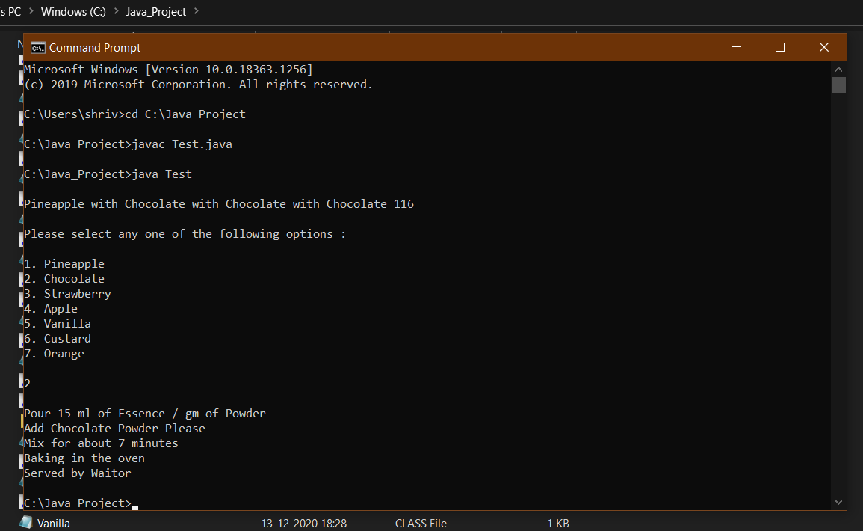
Output

Slide 29
Thank You

